Slide 1



Strategy of Kuopio
until 2030

Slide 2




Strategic management system of Kuopio
Strategy of Kuopio 2030: Capital of Good Life
Strategic programmes
Other plans and programmes
Urban structure plan
City-region plan
Land policy programme
Climate policy programme
Ownership policy
Rural area programme
Age-friendly Kuopio
Educational policy programme
Public transport programme
Procurement programme
Other plans and programmes
Growing
Kuopio
Happy and Healthy
Kuopio
Resource-wise Kuopio
Progressive
Kuopio
Monitoring and evaluation
Annual operational and financial planning
Budget and financial plan
(binding goals and the financial framework)
Utilisation plans for Service Areas
(measures to achieve the goals)
Management team
Development discussions
Development projects
Communications
Stakeholder engagement
Financial and operational plans
of affiliated units
Service contracts

Slide 3
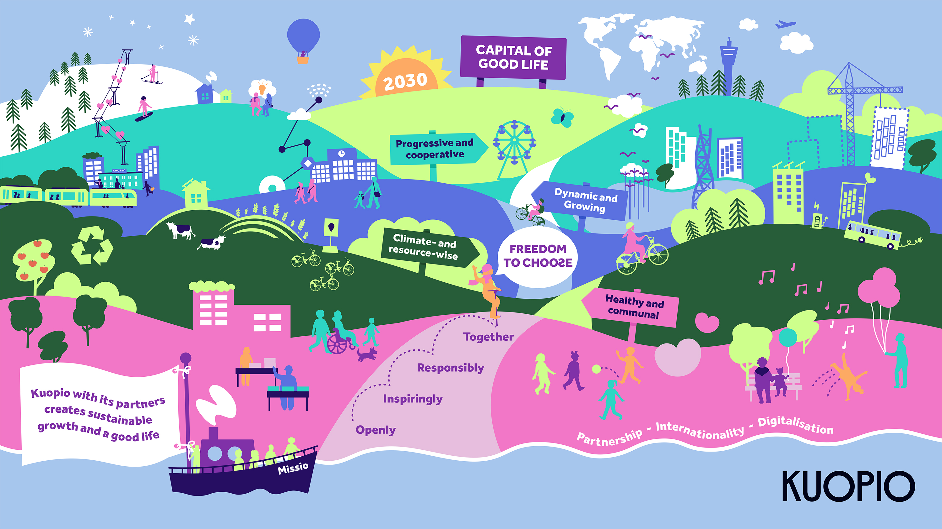

Slide 4



Menestystekijät
Goals
Success factors
Living environment and inclusion
Lifestyles and social networks that promote wellbeing
Lifelong learning, work and livelihood
Quality education and early childhood education and care
Meaningful leisure activities and experiences
Kuopio 2030
HEALTHY AND COMMUNAL
Safe for everyone – the best place to grow and learn
Partnership
Capital of Good Life
Competitive, encouraging environment for entrepreneurship
Bold, sustainable urban development
Attractive hub of innovation, research and expertise and high-quality education
Growing tourism and attractive events
Awareness of Kuopio and lobbying
Health, vitality and the richness of everyday life
DYNAMIC AND GROWING
Attractive for talent and business
Operation mode
Freedom to choose
Openly. Inspiringly. Responsibly. Together.
Internationality
CLIMATE- AND RESOURCE-WISE
Sustainably growing – proud of its environment
Circular economy and wise use of resources
Smart mobility and sustainable urban structure
Promoting biodiversity and preventing biodiversity loss
Security of supply and crisis tolerance
Mission
Kuopio with its partners creates sustainable growth and a good life
Digitalisation
Smooth, progressive operations
Progressive management
Skilled staff who are healthy and happy
Sustainable economy
PROGRESSIVE AND COOPERATIVE Happy and healthy work community

Slide 5
Capital of Good Life
– Health, vitality and the richness of everyday life
Our approach can be summed up in the phrase “Freedom to choose”. We work openly, inspiringly, responsibly, together.
This approach should be reflected in everything we do, not only in customer service but also within our organisation. Our ever-changing operating environment requires creativity and the courage to do things in new ways while also taking a critical look at established practices. We work responsibly and always consider the economic, social and environmental impact of our operations. We engage in cooperation across organisational boundaries and involve our residents in the development of our operations and services.

Slide 6

Success factors,
goals for
the term of Council
and metrics

Slide 7

Kuopio is proud to provide all the services that residents need to live a good life in a safe, comfortable residential and living environment. Safety in Kuopio means not only physical safety, but also social integrity. Kuopio puts children and young people first – it is a great place to grow up and pursue hobbies and education. We also support the wellbeing and quality of life of the elderly. We aim to strengthen the elements that nurture a good life for local residents and improve their opportunities to live a good life.
Healthy and communal
Safe for everyone – the best place to grow and learn

Slide 8

Kuopio is a sustainably growing university city and a world-renowned hub of research and education – a pioneer in health, environment and wellbeing. The city’s growth is driven by a progressive, international business sector, attractive career opportunities and tourism. Kuopio takes full advantage of its multifaceted environment and strives to provide attractive housing options for its residents also outside the city centre.
Dynamic and growing
Attractive for talent and business

Slide 9
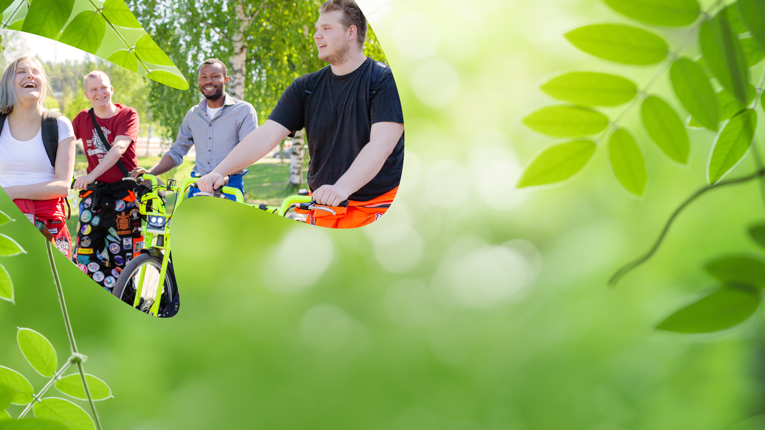
Versatile nature and a clean environment are some of the assets of Kuopio. The strain that growth places on the environment is controlled, and the city maintains its ambitious goals for climate- and resource-wisdom. We aim to be carbon-neutral by 2030 and be a pioneering city in circular economy.
Climate- and resource-wise
Sustainably growing – proud of its environment

Slide 10

The City of Kuopio has high attraction and retention power as an employer and constantly improves its services with the customer in mind. The staff of the City play a key role in the achievement of several strategic goals. As an employer, the City provides management and leadership that embraces listening and encouragement, and gives its staff room to make their own choices. A balanced economy enables effective services and the necessary investments.
Progressive and cooperative
Happy and healthy work community

Slide 11

Digitalisation
makes it possible to receive services at home, regardless of the time and place, to streamline operations and to create new business and service innovations.
Internationality
refers to opening doors for partners and giving them access to networks, raising awareness of the talent and assets of the region and interprofessional collaboration. It also means ensuring the readiness of the organisation as its partners and customers become increasingly international, responsibly fulfilling the integration duty of the municipality and upholding a general atmosphere of tolerance.
Partnership
means cooperation and networking to pursue common goals. Partnership is more than the sum of its parts – all parties benefit from it.

Slide 12


